Slide 1

CSE 299 Junior Design Course
Khan Afnan Rahad
1721578042

Slide 2
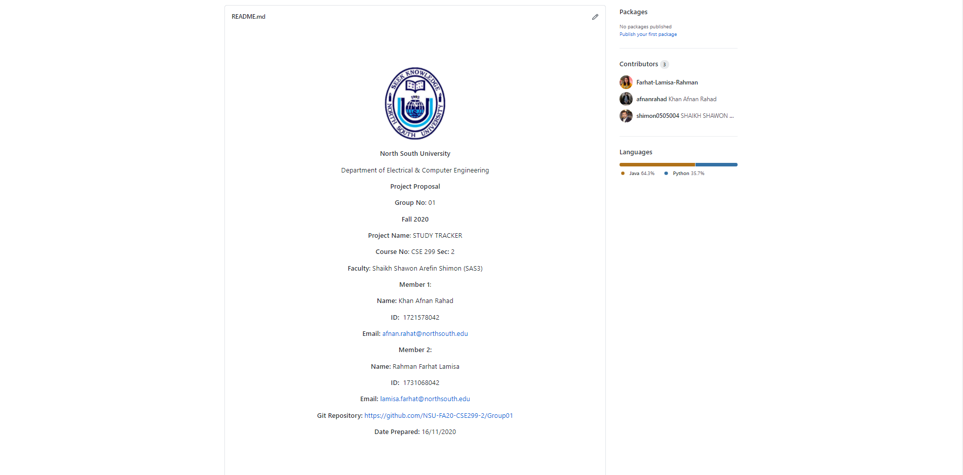
Readme.md

Slide 3
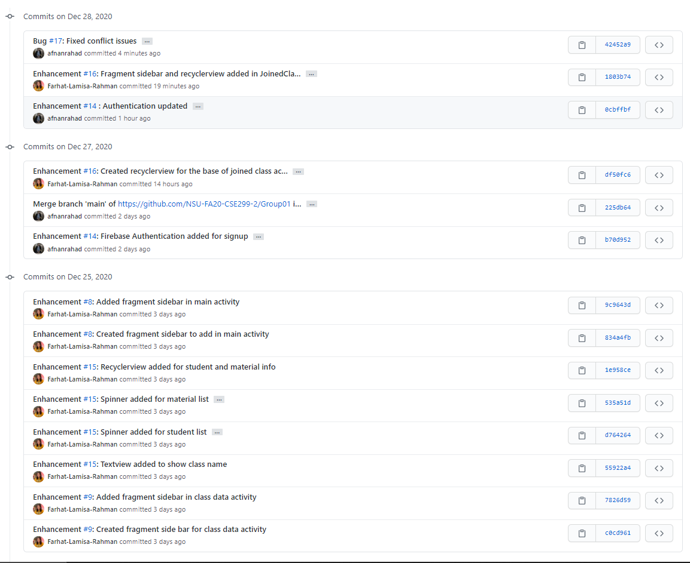
Commits

Slide 4
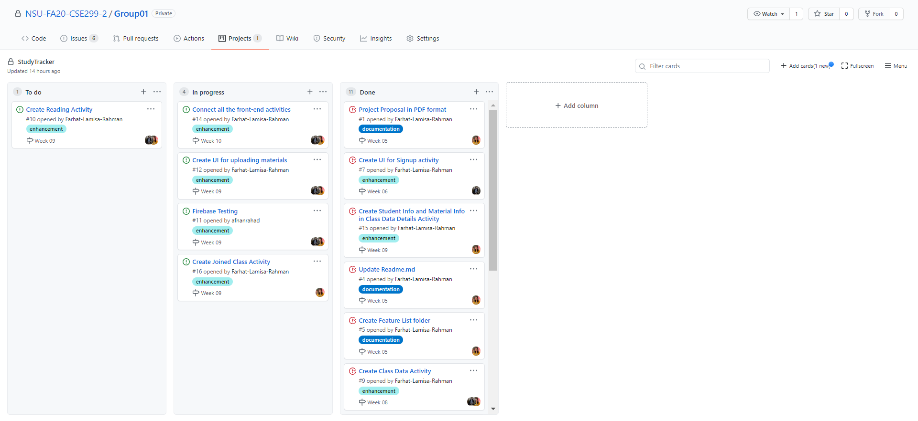
Issue Board

